Slide 1


Unit 6.3 Smart Objects

Slide 2

Unit Goal
This unit aims to introduce the concept of the smart object.

Slide 3

What is Smart Objects?

Slide 4
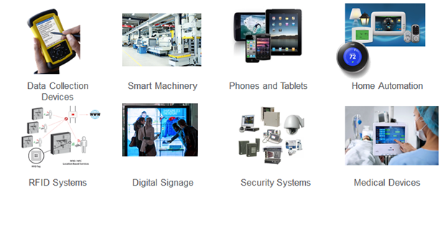
Smart Objects
A smart object is an object that enhances the interaction with other smart objects as well as with people also.
It is compounded by sensors and actuators.

Slide 5
Smart Objects
Sensors are electronic devices composed of sensitive cells that can measure physical.
An actuator is a machine component responsible for moving and controlling a mechanism or system, for example, by opening a valve.

Slide 6
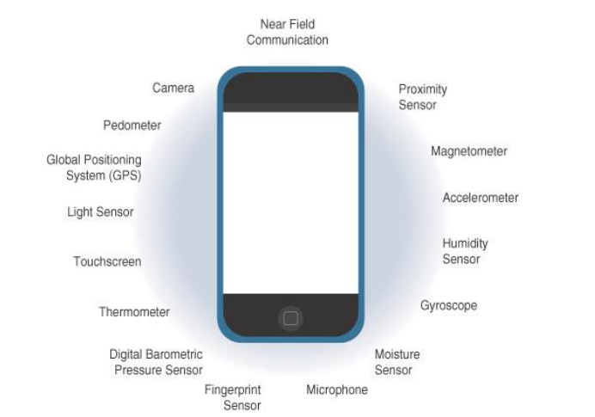
Smartphone Sensors

Slide 7
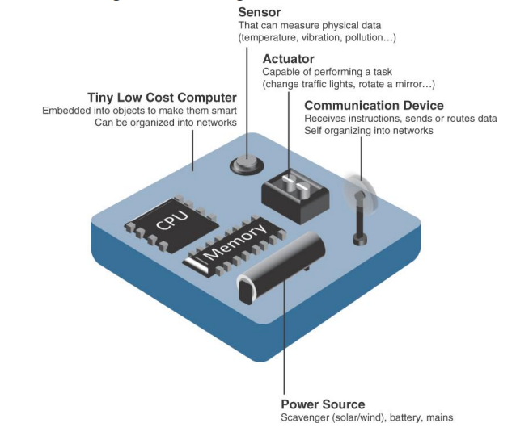
Smart Object
A smart object, is a device that has, at a minimum, the following four defining characteristics

Slide 8
Trends in Smart Objects
Size is decreasing
Power consumption is decreasing
Processing power is increasing
Communication capabilities are improving
Communication is being increasingly standardized

Slide 9
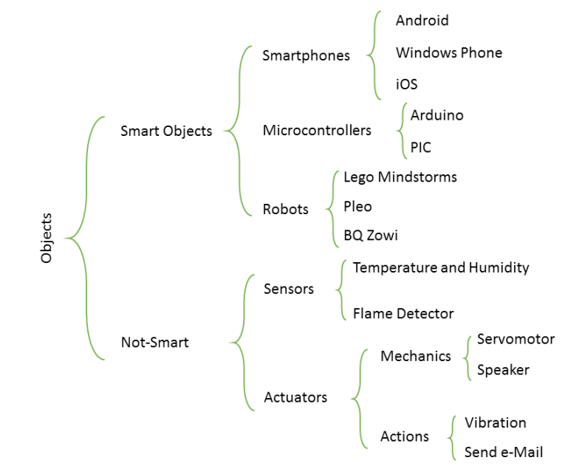
Smart Objects Summary

Slide 10
Unit 6.3 Smart Objects

